Slide 1

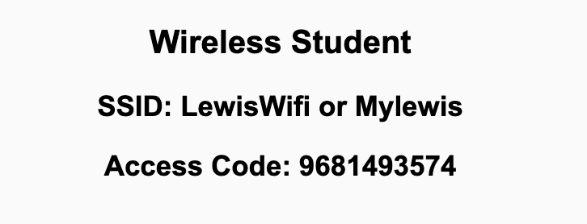
Preflight Check List
Sign into our Zoom meeting through our integrated Blackboard/Zoom link
Make sure that you can hear the conversation, see shared desktops, and view chat topics
Thank you if you choose to leave your camera on to help make our class more interactive
Be prepared to share your computer screen
Be prepared to utilize a headset with a microphone
In person participants also:
Make sure that your microphone and speakers are muted/off so that we don’t get an echo
Sit in a good spot near the classroom ceiling microphones if possible

Slide 2
Recordings
Discuss that recording are:
Opportunistic
Automatically available in Blackboard/Zoom
Start Recording

Slide 3
Agenda:
Friendly Conversation Topic: What is the Command Line Interface (CLI)? Plus Team7?
Prework and Announcements
Sprint Progress Polling and CLIs
Scrum Team Discussion of “Programming The World Wide Web” chapter 2
Prework for Next Class
Lab (as time allows)
Discussion & Questions welcome at any time but please be present with no phones or email during our time together

Slide 4
What is the Command Line Interface?
According to W3C
According to Hostinger Tutorials

Slide 5
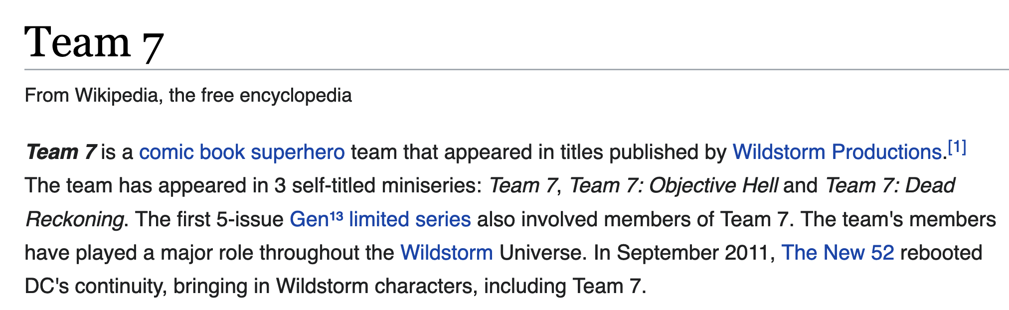
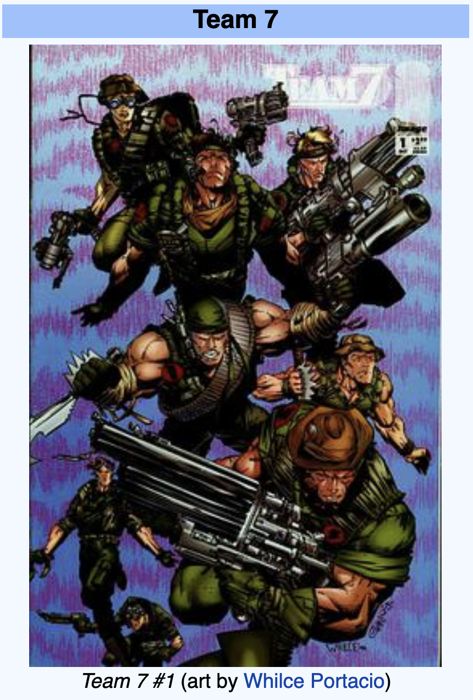
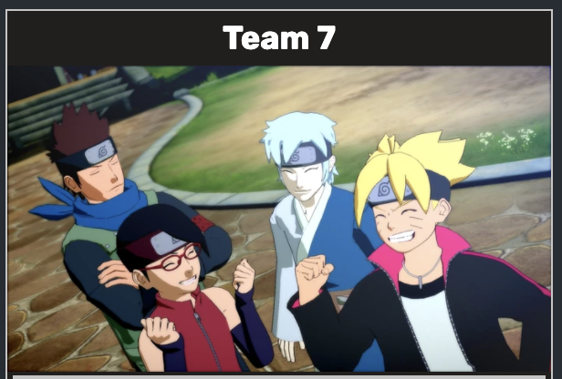
Who Is Team 7?
Or Team 7?

Slide 6
Prewor
Prior to our next class please:
Complete through activity 10 prior to next class
Be prepared for your Scrum Team review and report out of “Programming The World Wide Web” chapter 2
Recall: Fridays are fully remote sessions.

Slide 7
Polling – Sprint Progress and CLIs

Slide 8
Breakout Discussion on Sebesta chapter 2
Assigning presenter
Discussing key chapter topics while the presenter summarizes the topics below:
History and evolution… What standard should we utilize for web applications today?
Syntax and basic structure… Are these things that you are already familiar with?
Text markup, images, and links… What are other popular markup languages?
Everything else… Why should we care about XHTML? Should we care about XHTML?
Team sits back, relaxes, and acknowledges the bravery and dedication of the presenter

Slide 9
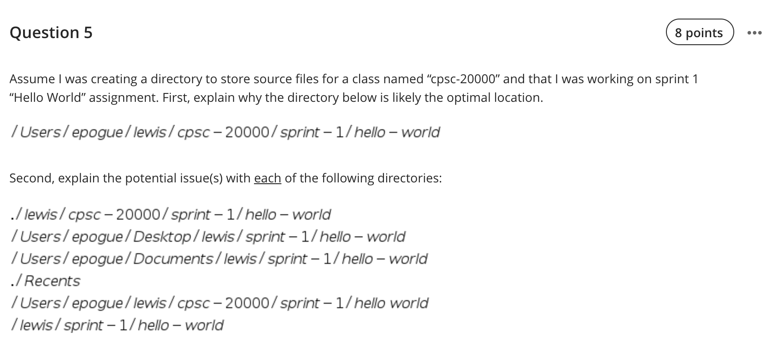
Review Lab 1 Question 5 on File Systems

Slide 10
Review Lab 1 Question on File Systems

Slide 11
Prework For Next Class
No class Monday due to the Labor Day holiday.
Prior to our Wednesday class please:
Complete through activity 13 prior to next class
Be mostly complete with activity 14
Be prepared for your Scrum Team review and report out on Sebesta chapter 1
Be prepared for Quiz 1

Slide 12
Lab (as time allows)
Command Line Interfaces (CLIs)
Tools of the Trade

Slide 13
Where should I put my files?

Slide 14
End of Session

Slide 15

History of Website Infrastructure Cost/Time
Year | Acquisition Cost | Annual Cost | Time to Production | Reference
1995 | $500,000 | $100,000 | 6 months | Parsons Technology
2000 | $250,000 | $50,000 | 3 months | John Deere
2005 | $10,000 | $2,000 | 1 week
2010 | $1,000 | $200 | < 1 week | GoDaddy (personal)
2015 | $100 | $20 | < 1 day | GoDaddy (personal)
2018 | ~$0 | ~$0 | < 5 min | Azure (personal)

